Slide 1

P peline
The Data
Introduction
© Jennifer Mankoff
The Data Pipeline; HCII; Spring 2014

Slide 2
Stay in the room if you want to
Learn about problems with data collection, use and interpretation
Learn about techniques for visualizing and interpretation of data
Explore applied examples of data use
Explore the end user experience of data
Develop a portfolio of data-driven applications
Notes:
Close your laptop and phone please

Slide 3
What is your background?
Notes:
Class exercise: do this on index cards and tape them up under the area of greatest expertise

Slide 4
What did we learn?
Question
Is it the right question?
Collect Data
Is it the right data for the question?
How hard/easy is it to collect?
Is it answerable?
Stats/Graphs/ML
Intuition
Explore Data

Slide 5
Sampling of courses at CMU
70455 Modern Data Management ([S14]; Business Administration)
19704 Applied Data Analysis ( [S14]; EPP)
67362 Big Data Analytics ([S14]; H&SS Information Systems)
95791 Data Mining ([F13 & S14]; IS school of IS & Mgmt)
95868 Exploring and Visualizing Data ([S14]; IS school of IS & Mgmt)
08741 Seminar in Data Science ( [F13 & S14]; Institute for Software Research)
08711 Data Mining, CRM ([F13 & S14]; Institute for Software Research)
08749 Data Science Systems Capstone ([F13]; Institute for Software Research)
15648 Studio in Big Data Systems ([S14]; Computer Science)
15649 Seminar Data Systems ([S14]; Computer Science)
15826 Multimedia Databases and Datamining ([F13]; Computer Science)
94832 Business Intelligence & Data Mining SAS ([S14] & Li [F13]; Heinz [S])
11675 Big Data Systems for Biotechnology ( [S14], Vu [F13]; LTI)
10605 Machine Learning with Large Datasets ( [S14]; Machine Learning)
91801 Data Analysis for Managers ( [S14][F13]; Public Management)
90866 Large Scale Data Analysis for Public Policy ( [S14]; Public Policy & Mgmt)
36402/36608 Advanced Methods for Data Analysis ([S14]; Statistics)
36601 Perspectives in Data Science I ([F13]; Statistics)
36602 Perspectives in Data Science II ([S14]; Statistics)
36618 Topic in Data Analysis [S14]; Statistics)
36757 Advanced Data Analysis I ([S14]; Statistics)
36758 Advanced Data Analysis II ([F13]; Statistics)
45851 Data Mining ([S14]; Tepper)
45980 Big Data ( [S14]; Tepper)
05434 Machine Learning in Practice ( [S14 & F13]; HCI)
05839 The Data Pipeline: Collecting and Using Data for Interactive Systems ([S14]; HCI)
12740 Data Acquisition ([F13]; CEE)
12741 Data Management ( [F13]; CEE)

Slide 6
An Alternative Profile?

Slide 7
What did we learn?
Question
Is it the right question?
Collect Data
Is it the right data for the question?
How hard/easy is it to collect?
Clean Data
What flaws exist in the data?
How do we address them?
Is it answerable?
Explore Data
Stats/Graphs/ML
Intuition

Slide 8
What did we learn?
Question
Is it the right question?
Collect Data
Is it the right data for the question?
How hard/easy is it to collect?
Clean Data
What flaws exist in the data?
How do we address them?
Is it answerable?
Explore Data
Stats/Graphs/ML
Use data
Communicate/Predict/…
Intuition

Slide 9
A full data pipeline
Question
Is it the right question?
Collect Data
Is it the right data for the question?
How hard/easy is it to collect?
Clean Data
What flaws exist in the data?
How do we address them?
Is it answerable?
Explore Data
Intuition
Use data
Communicate/Predict/…
Stats/Graphs/ML
Report on Findings
Visualize

Slide 10
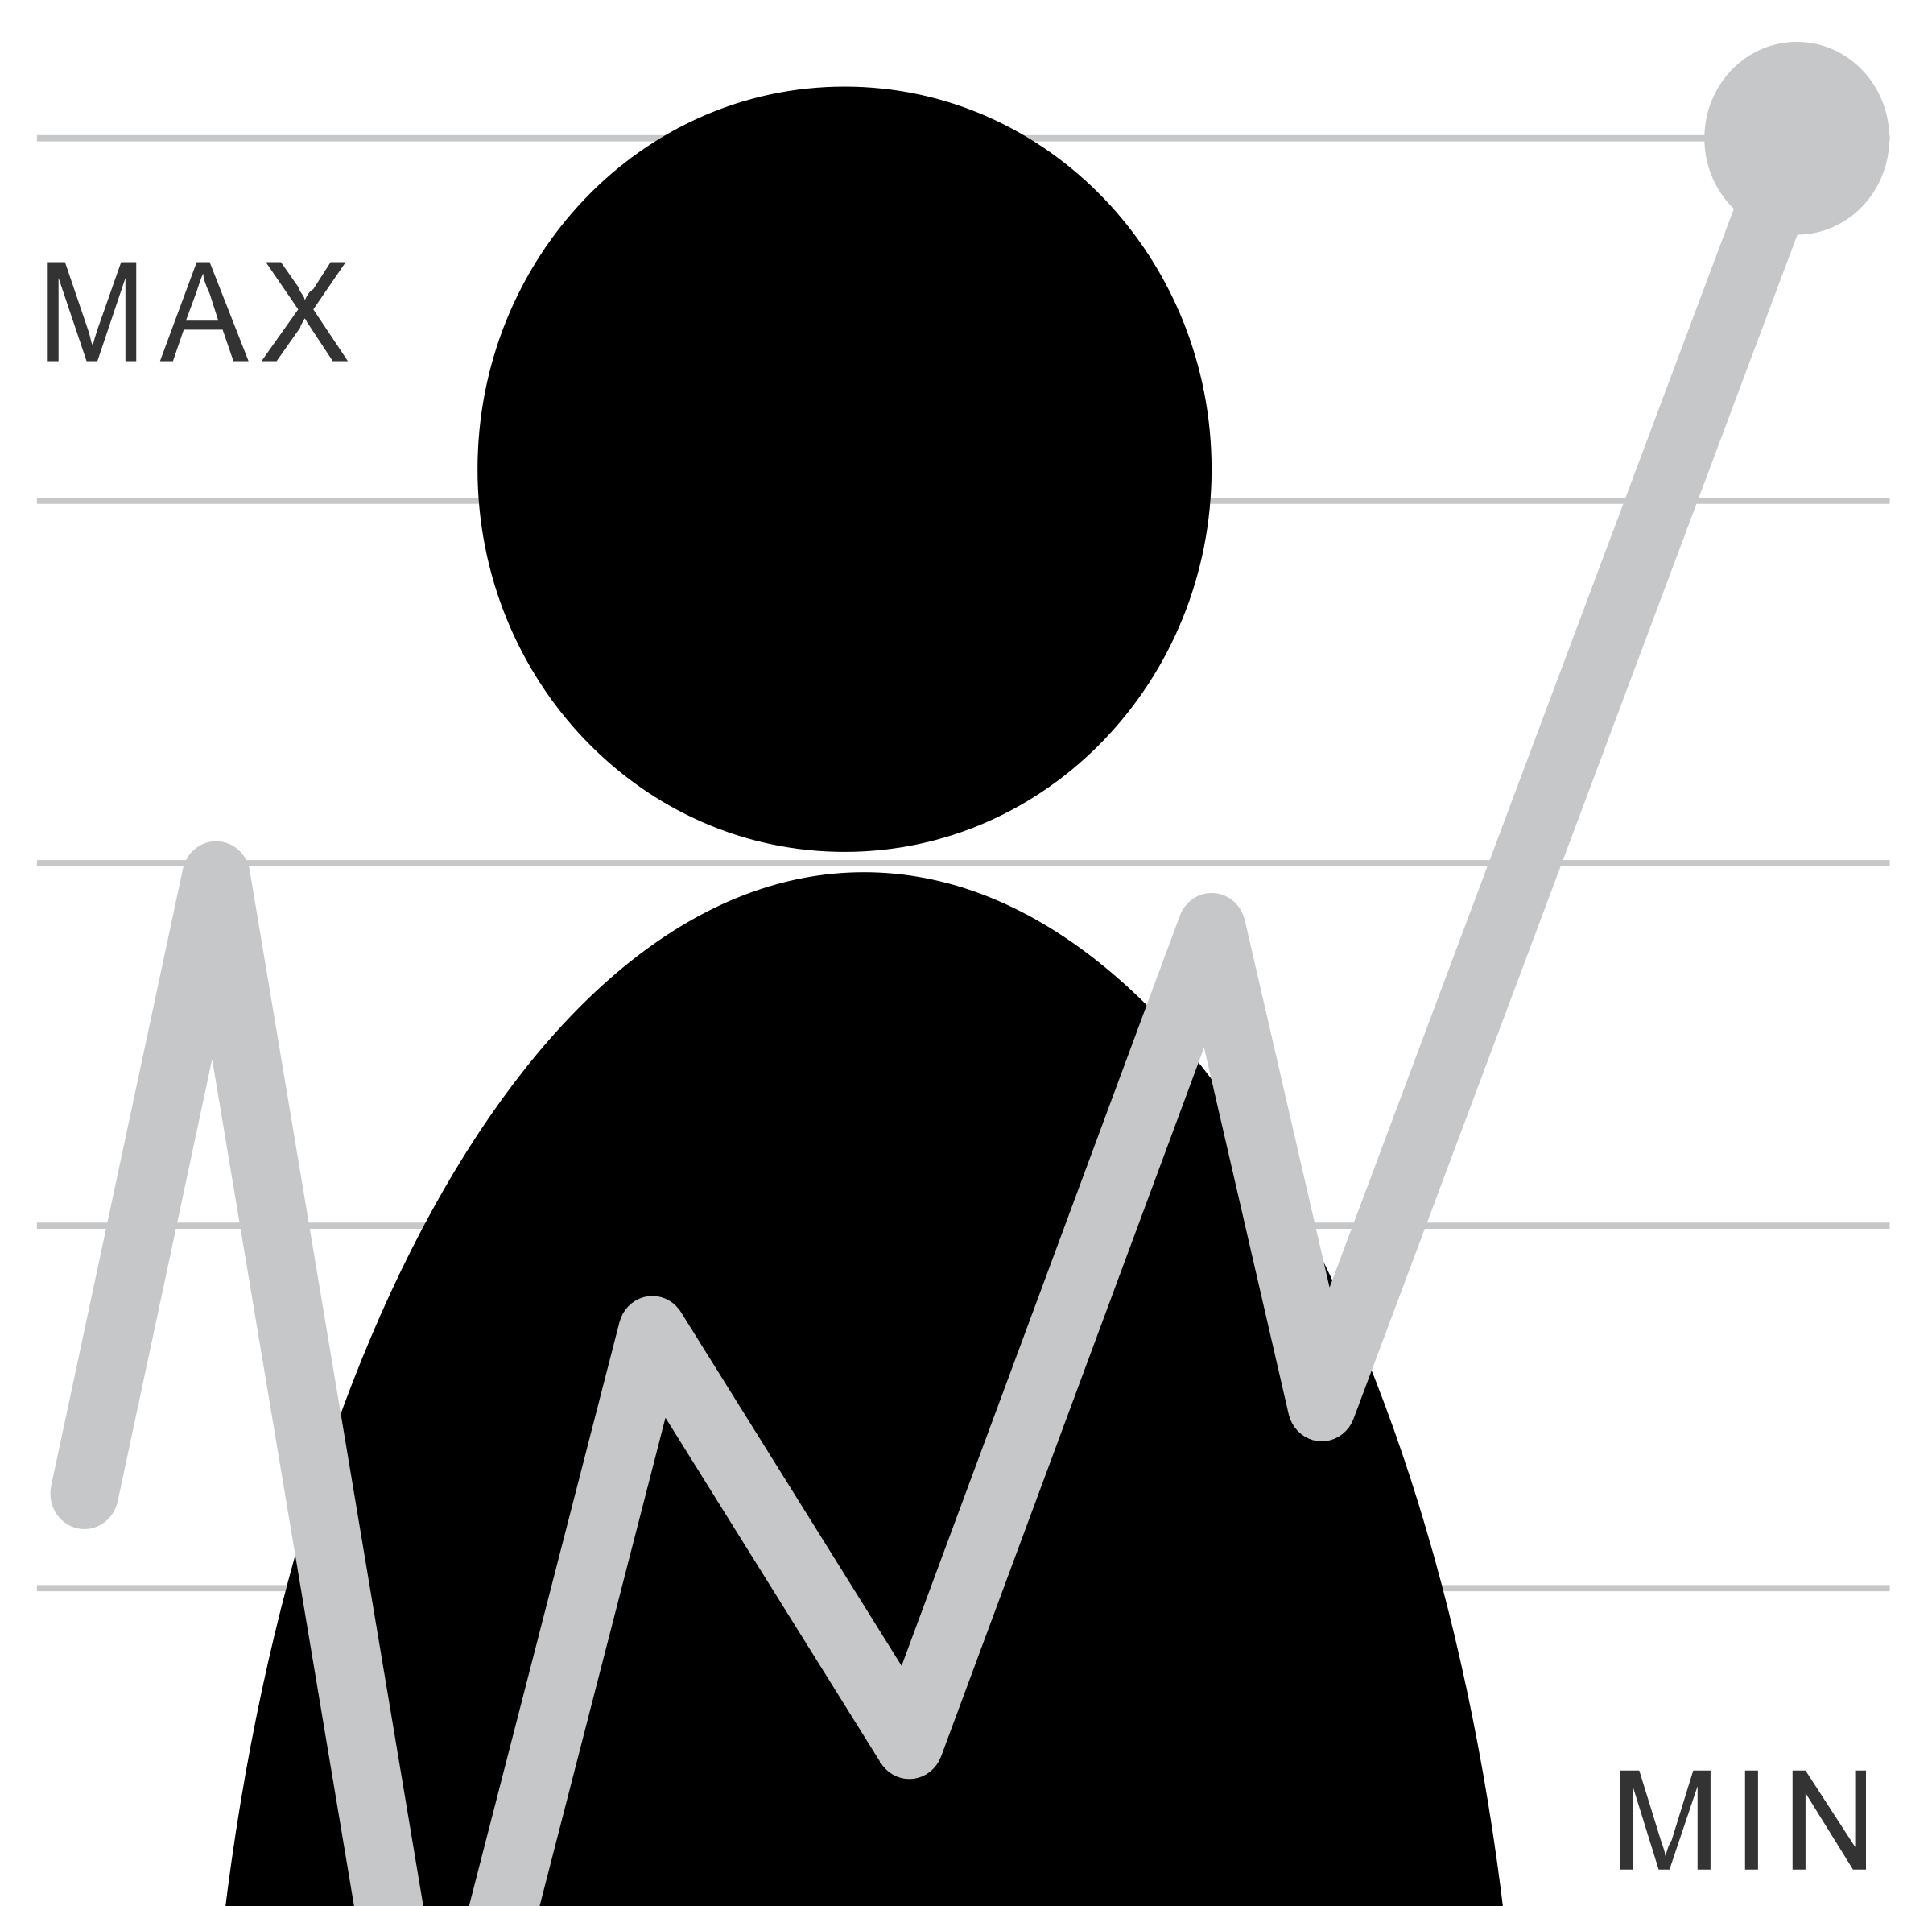
Where are end users implicated?
Question
Is it the right question?
Collect Data
Is it the right data for the question?
How hard/easy is it to collect?
Clean Data
What flaws exist in the data?
How do we address them?
Is it answerable?
Explore Data
Intuition
Use data
Communicate/Predict/…
Stats/Graphs/ML
Report on Findings
Visualize

Slide 11
Where are end users implicated?
Question
Is it the right question?
Collect Data
Is it the right data for the question?
How hard/easy is it to collect?
Clean Data
What flaws exist in the data?
How do we address them?
Is it answerable?
Explore Data
Intuition
Use data
Communicate/Predict/…
Stats/Graphs/ML
Report on Findings
Visualize

Slide 12
Where are end users implicated?
Question
Is it the right question?
Collect Data
Is it the right data for the question?
How hard/easy is it to collect?
Clean Data
What flaws exist in the data?
How do we address them?
Is it answerable?
Explore Data
Intuition
Use data
Communicate/Predict/…
Stats/Graphs/ML
Report on Findings
Visualize

Slide 13
Where are end users (and HCI) implicated?
Question
Is it the right question?
Collect Data
Is it the right data for the question?
How hard/easy is it to collect?
Clean Data
What flaws exist in the data?
How do we address them?
Is it answerable?
Explore Data
Intuition
Use data
Communicate/Predict/…
Stats/Graphs/ML
Report on Findings
Visualize

Slide 14
How about Statistics
Question
Is it the right question?
Collect Data
Is it the right data for the question?
How hard/easy is it to collect?
Clean Data
What flaws exist in the data?
How do we address them?
Is it answerable?
Explore Data
Intuition
Use data
Communicate/Predict/…
Stats/Graphs/ML
Report on Findings
Visualize

Slide 15
How about Programming
Question
Is it the right question?
Collect Data
Is it the right data for the question?
How hard/easy is it to collect?
Clean Data
What flaws exist in the data?
How do we address them?
Is it answerable?
Explore Data
Intuition
Use data
Communicate/Predict/…
Stats/Graphs/ML
Report on Findings
Visualize

Slide 16
How about Machine Learning
Question
Is it the right question?
Collect Data
Is it the right data for the question?
How hard/easy is it to collect?
Clean Data
What flaws exist in the data?
How do we address them?
Is it answerable?
Explore Data
Intuition
Use data
Communicate/Predict/…
Stats/Graphs/ML
Report on Findings
Visualize

Slide 17
How about Visualization
Question
Is it the right question?
Collect Data
Is it the right data for the question?
How hard/easy is it to collect?
Clean Data
What flaws exist in the data?
How do we address them?
Is it answerable?
Explore Data
Intuition
Use data
Communicate/Predict/…
Stats/Graphs/ML
Report on Findings
Visualize

Slide 18
How about Communication
Question
Is it the right question?
Collect Data
Is it the right data for the question?
How hard/easy is it to collect?
Clean Data
What flaws exist in the data?
How do we address them?
Is it answerable?
Explore Data
Intuition
Use data
Communicate/Predict/…
Stats/Graphs/ML
Report on Findings
Visualize
Notes:
----- Meeting Notes (1/14/14 09:55) -----
data modeling
storage

Slide 19
Administrata
Class Participation: No Phones or Laptops
Why? http://tinyurl.com/no-tech-in-class
Key quote: “students who multitask on laptops in class distract not just themselves but also their peers”
Reading assignments: two posts to discussion group on day before each reading is due

Slide 20
Administrata
Class Participation: No Phones or Laptops
Several small “Byte” sized exercises
Stepping stones to larger projects
Peer graded
Individual work
Tutorials and some sample code provided
First one due Monday

Slide 21
Administrata
Class Participation: No Phones or Laptops
Several small “Byte” sized exercises
Two to three larger projects
Final one very self-defined
May be done in groups
Peer graded with instructor feedback

Slide 22
Administrata
Class Participation: No Phones or Laptops
Several small “Byte” sized exercises
Two to three larger projects
Occasional quizzes & 1 take home final exam
Quizzes small and unannounced

Slide 23
Grading
10% Class Participation
30% Project Bytes [peer graded]
50% Full Projects
10% Final Exam

Slide 24
Pre-requisites
Aim to engage a range of programming abilities (primarily using python)
Comfort with programming and debugging important
Byte 1 (first assignment) will help you judge: due Monday for this reason
We assume no background in machine learning, databases, or statistics.

Slide 25
Other details
Large class, small staff (just me right now!)
Hoping to let everyone in
Other Details
Guest lectures still TBD
In-class Hack Sessions & Presentations for Instructor Feedback

Slide 26
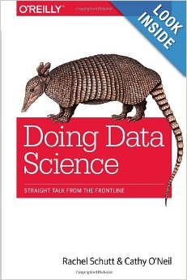
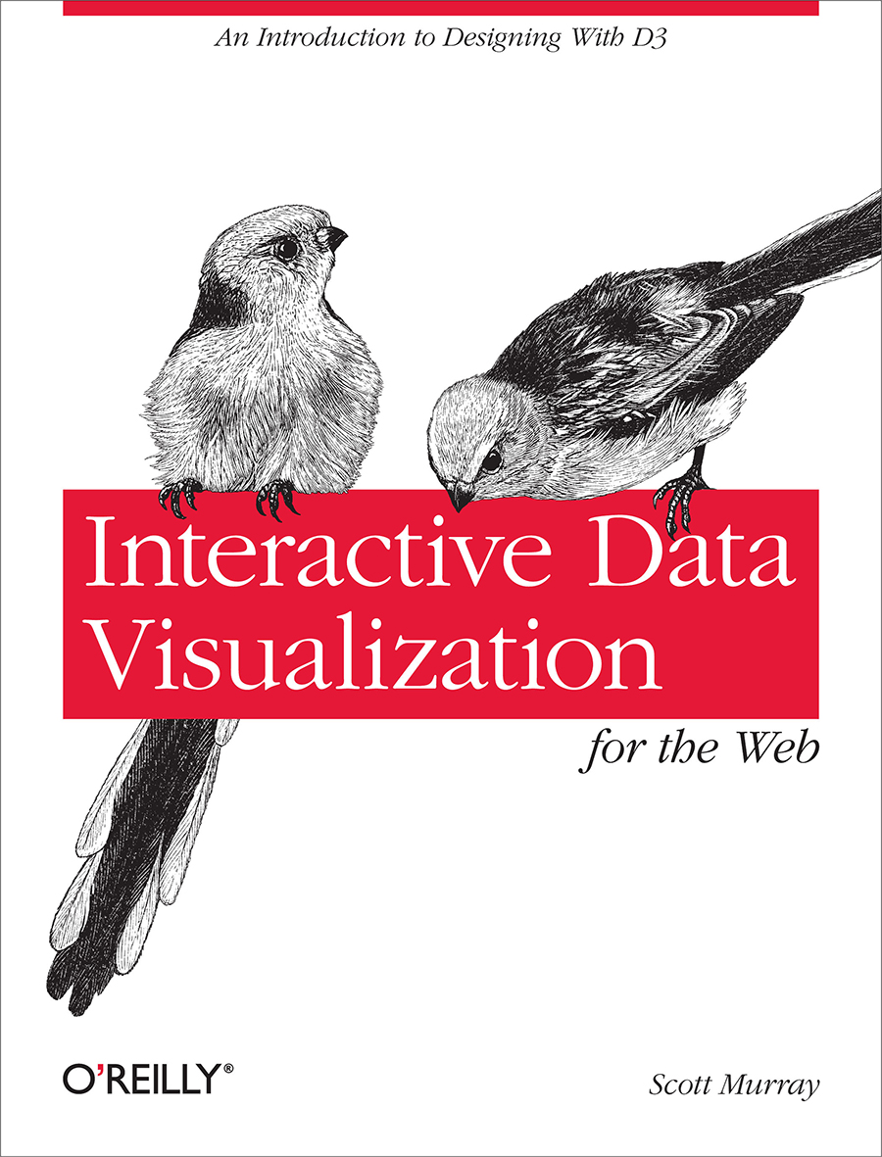
Recommended Texts

Slide 27
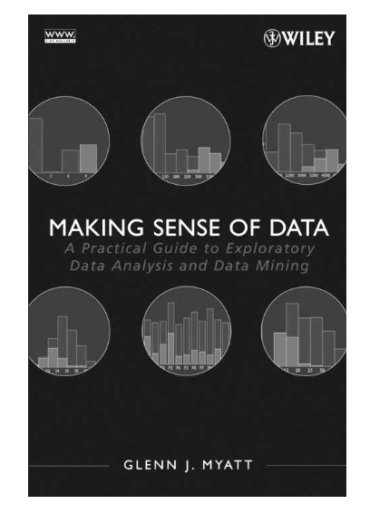
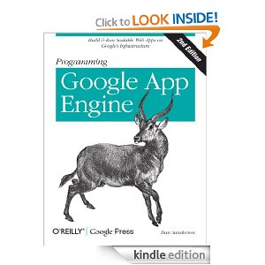
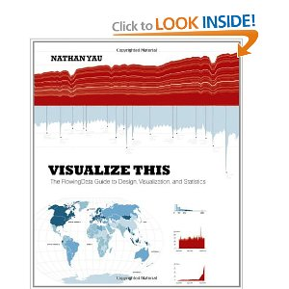
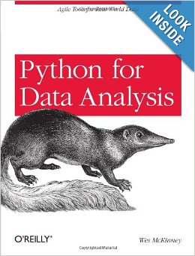
More books to consider

Slide 28
Where to find the class
Blackboard
Data.cmubi.org
https://github.com/jmankoff/data/
Slides & Source code
Note: Version control is your friend!!! You should consider joining github now, you will be required to use it for the bigger projects.

Slide 29
Where to find me
Newell Simon Hall 3612E
Office Hours: After class on Tuesdays
Schedule: data.cmubi.org/calendar
Email: jmankoff@cs.cmu.edu
Yes or no questions please

